Slide 1

Hotel Booking Status Prediction
using Machine Learning
Lan Dinh – 300383107
Oluwajomiloju Aluko – 300421018
Jaspreet Baweja – 300393820
Roshni Batra - 300415575
Source: Kaggle.com

Slide 2
Project Overview
This project focuses on predicting hotel booking cancellations using a full machine learning pipeline. We tested multiple preprocessing methods, feature selection techniques, and models to identify the most accurate solution for real hotel environments.

Slide 3
DATASET
18
NO
36K
FEATURES
NULL VALUES | DUPLICATES
RECORDS
13 numeric, 3 categorical, 1 ID
OVERVIEW

Slide 4
Feature | Type | Description
Booking_ID | Object | Unique identifier for each booking
no_of_adults | Int | Number of adults per reservation
no_of_children | Int | Number of children per reservation
no_of_weekend_nights | Int | Number of weekend nights booked
no_of_week_nights | Int | Number of weekday nights booked
type_of_meal_plan | Categorical | Type of meal plan selected
required_car_parking_space | Int | Whether parking is required (0/1)
room_type_reserved | Categorical | Type of room selected
lead_time | Int | Number of days before arrival the booking was made
arrival_date | Date | Date of arrival
market_segment_type | Categorical | Source of booking (Online, Corporate, etc.)
repeated_guest | Int | Whether the guest has stayed before (0/1)
no_of_previous_cancellations | Int | Previous cancellations by the customer
no_of_previous_bookings_not_canceled | Int | Previous successful bookings
avg_price_per_room | Float | Average price per night per room
no_of_special_requests | Int | Number of special requests made
booking_status | Categorical | Target variable — “Canceled” or “Not_Canceled”
DESCRIPTION

Slide 5
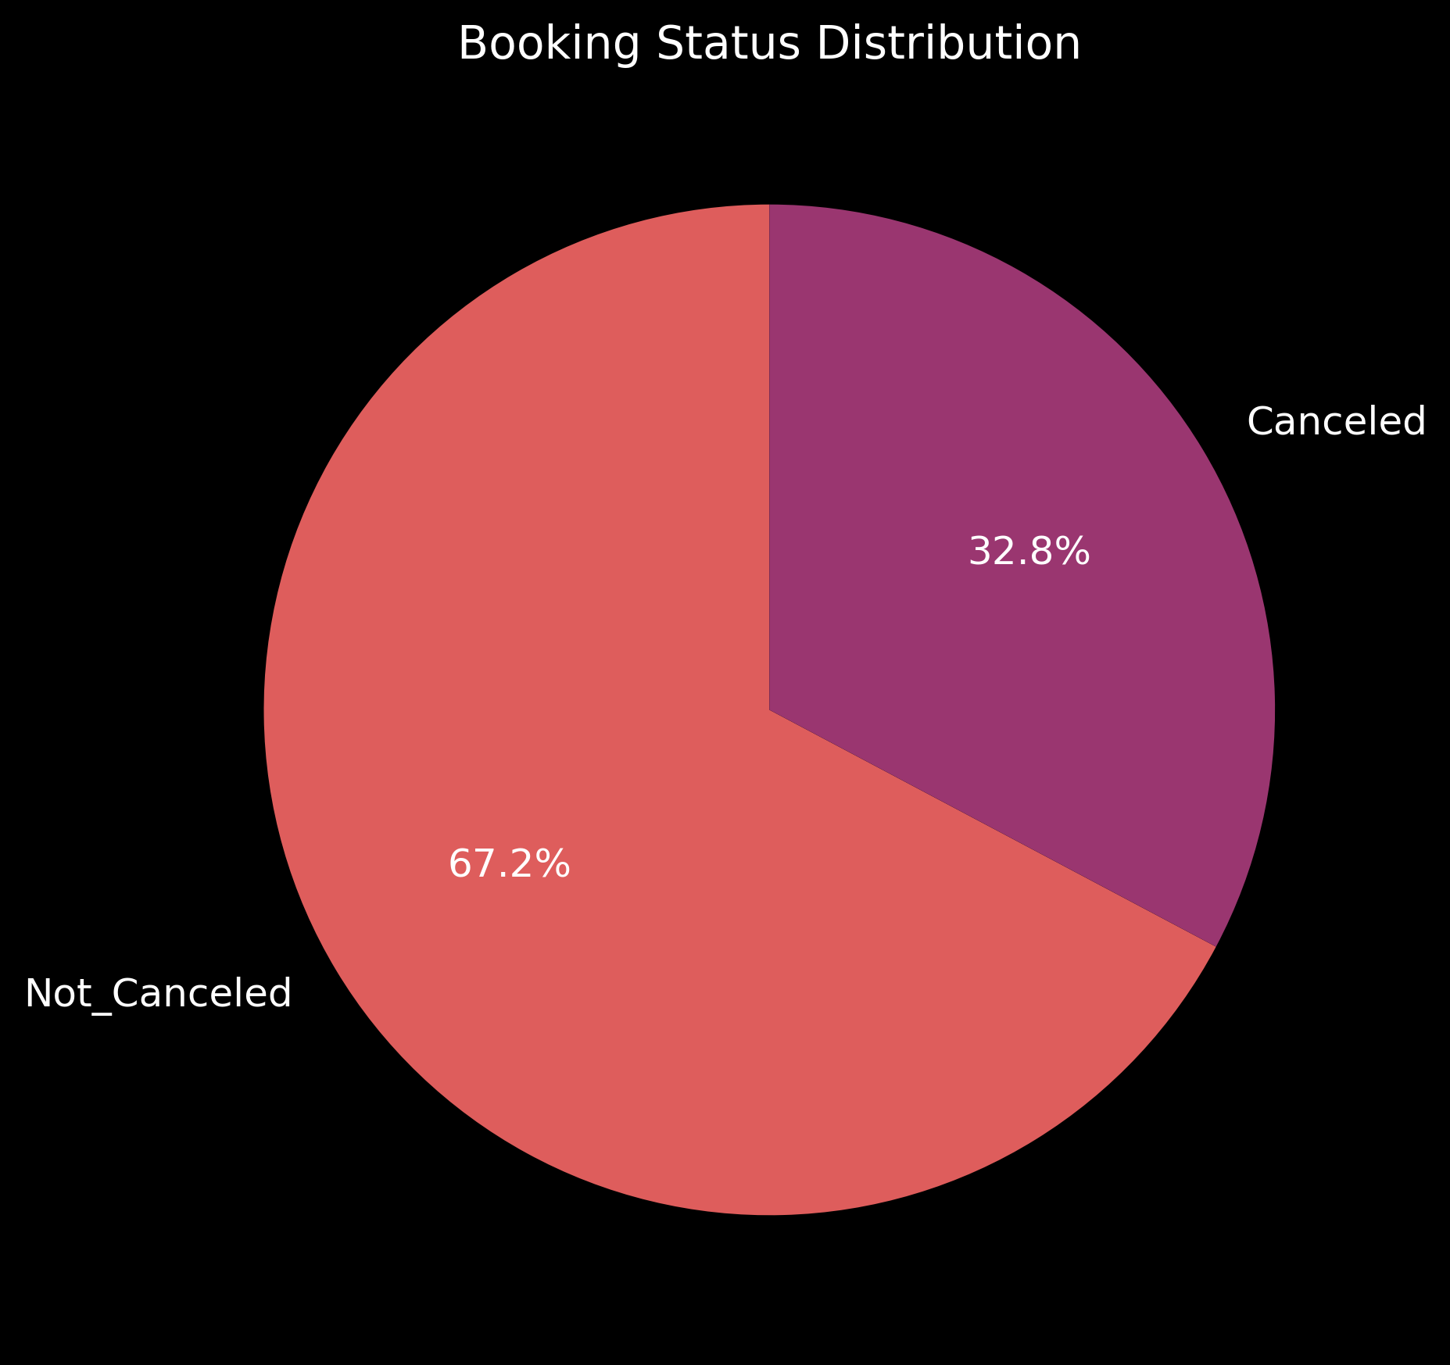
VISUALIZATIONS
Imbalanced
Dataset

Slide 6
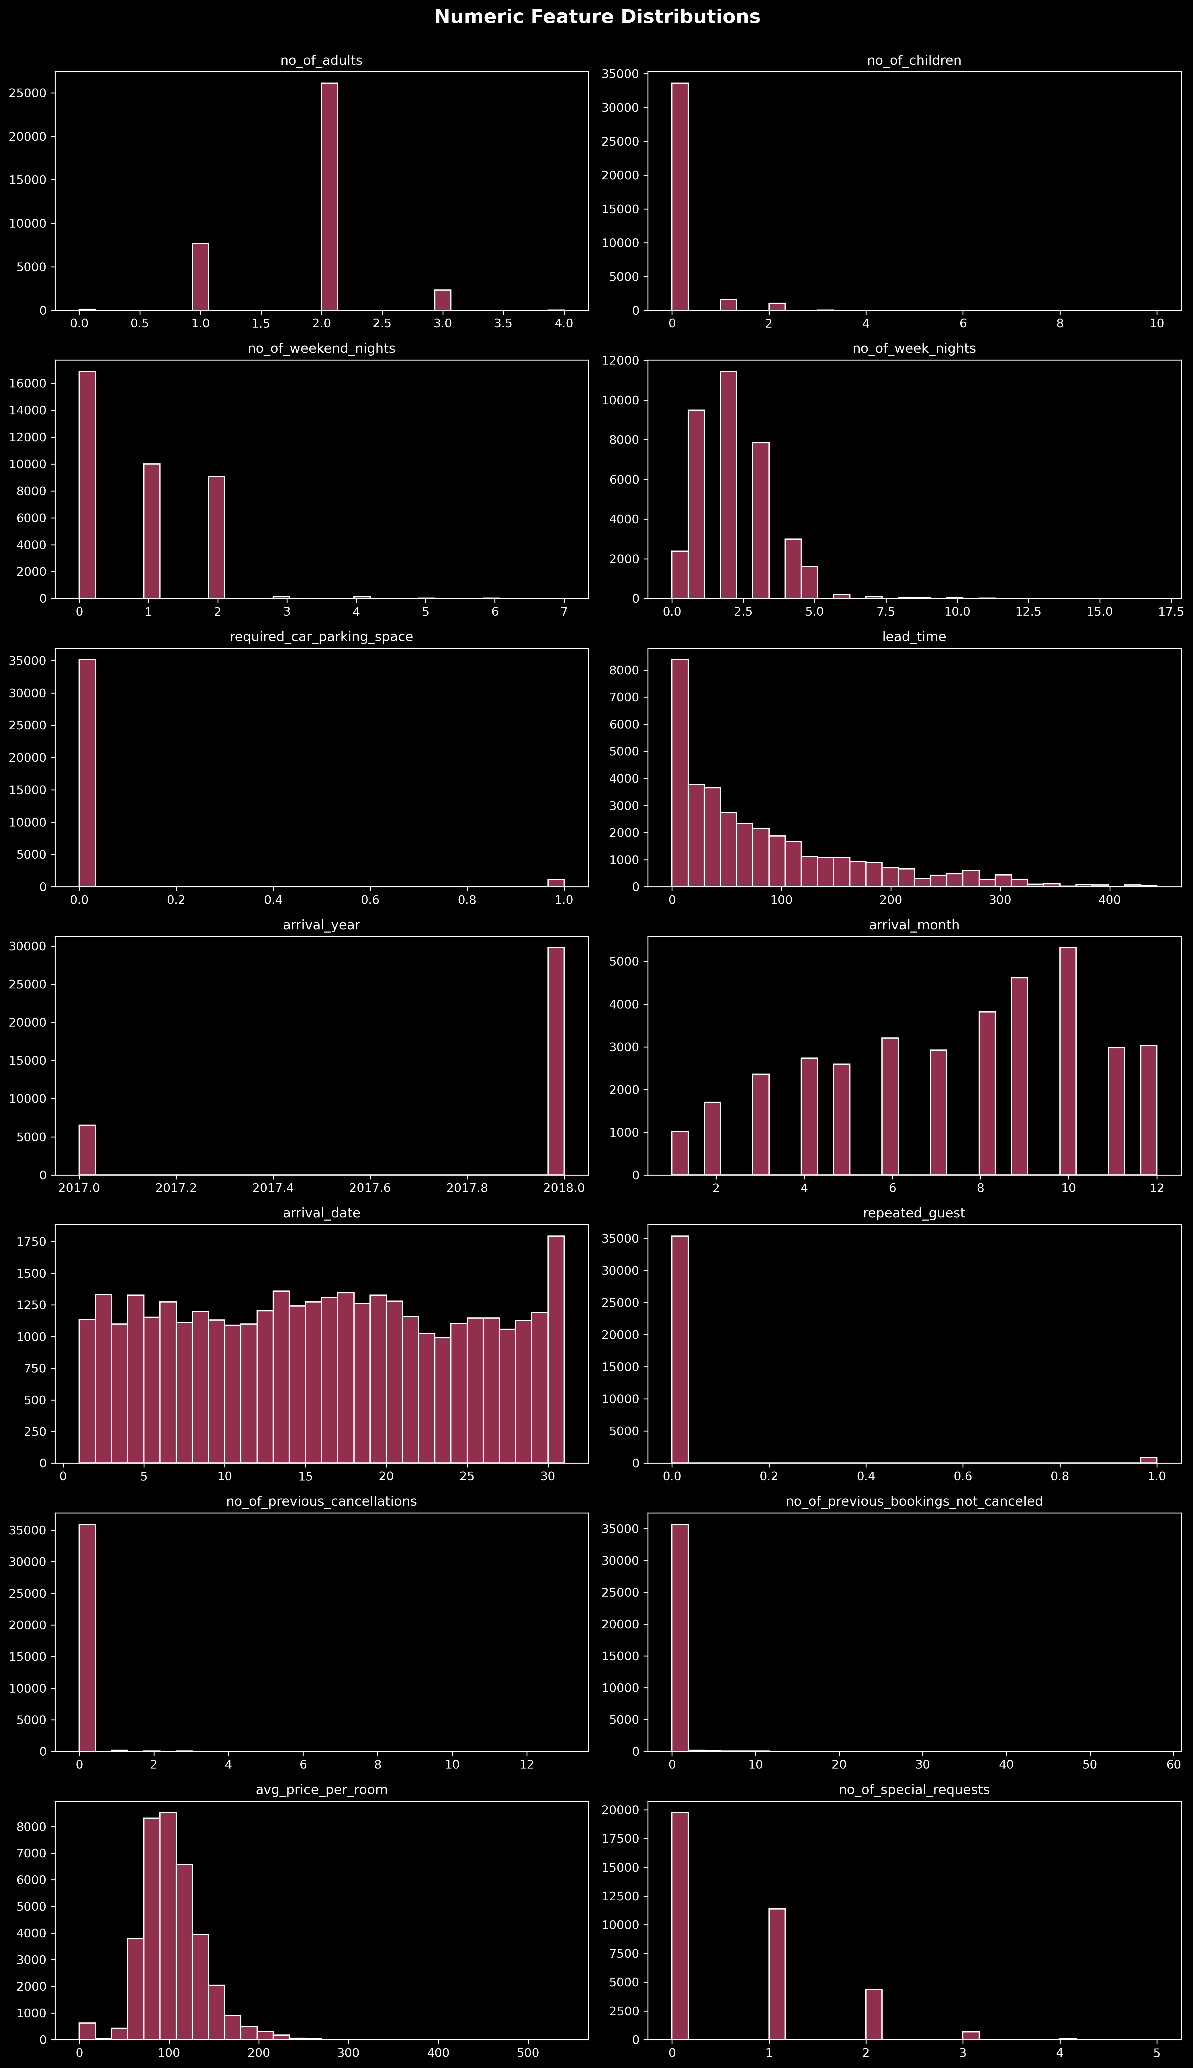
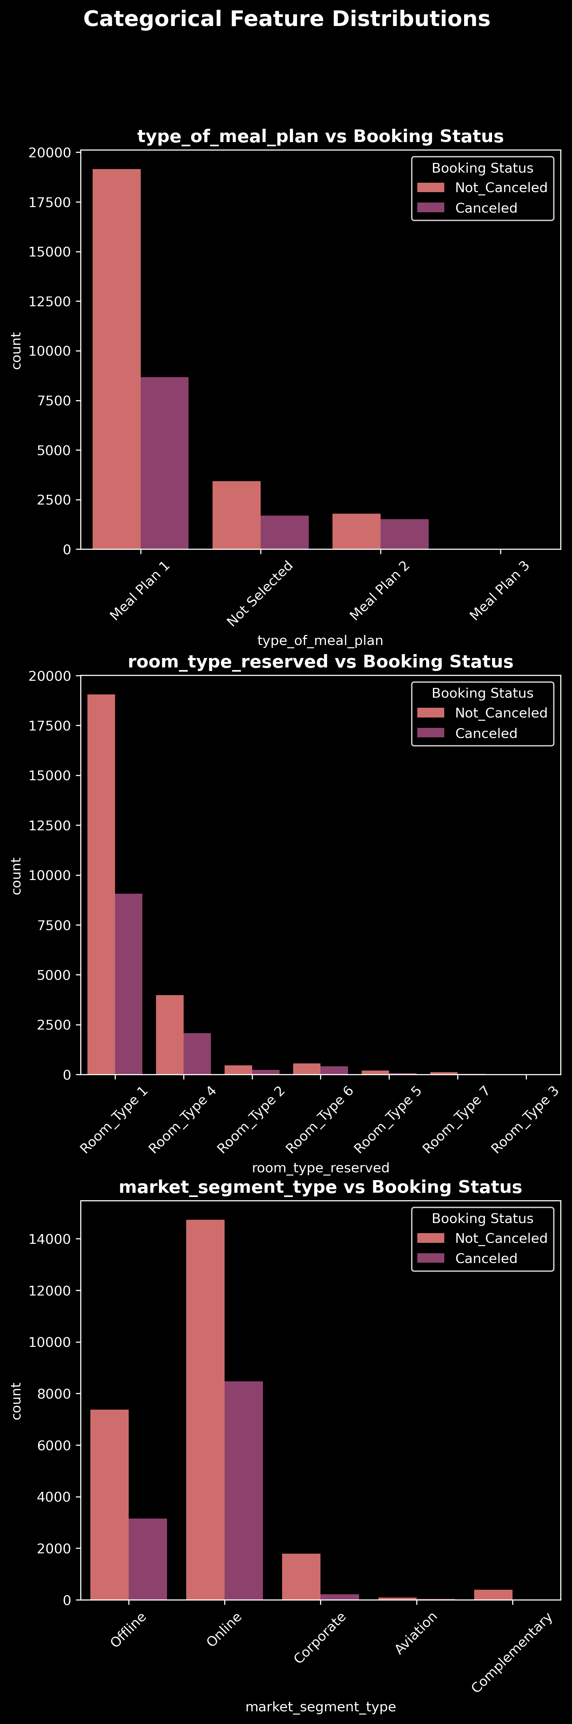
VISUALIZATIONS

Slide 7
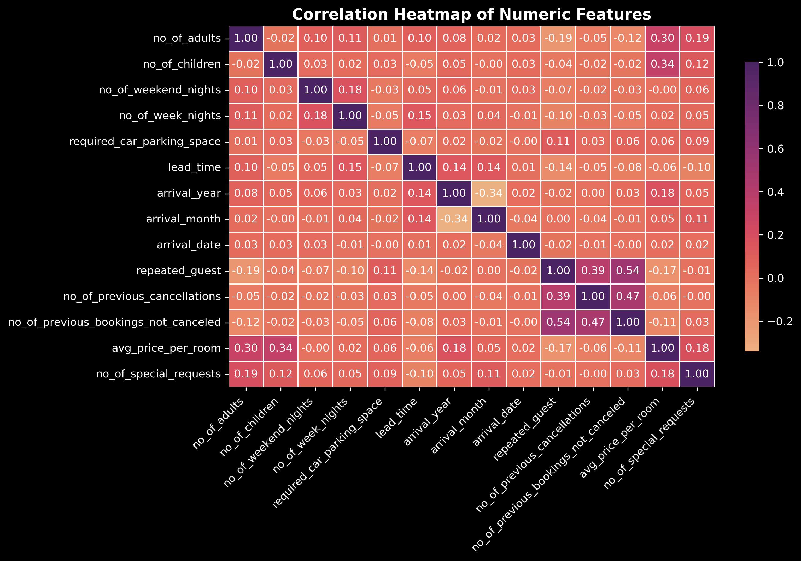
CORRELATION

Slide 9
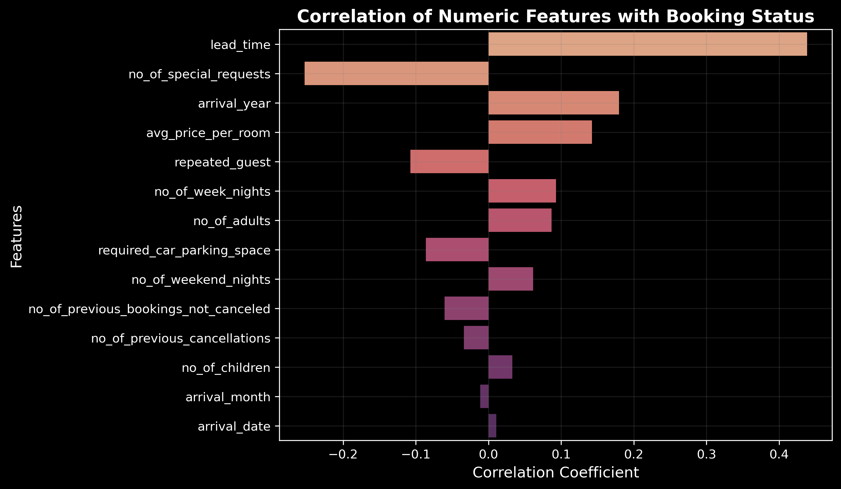
STRONG PREDICTORS

Slide 10
PIPELINE
Data Pre-processing
Feature Engineering
Drop Booking_ID
Encode Target: Canceled = 1
Not Canceled = 0
Numeric features scaled with StandardScaler
Categorical features encoded with OneHotEncoder
The dataset was split into training (75%) and testing (25%) sets using stratified sampling to maintain class balance.

Slide 11
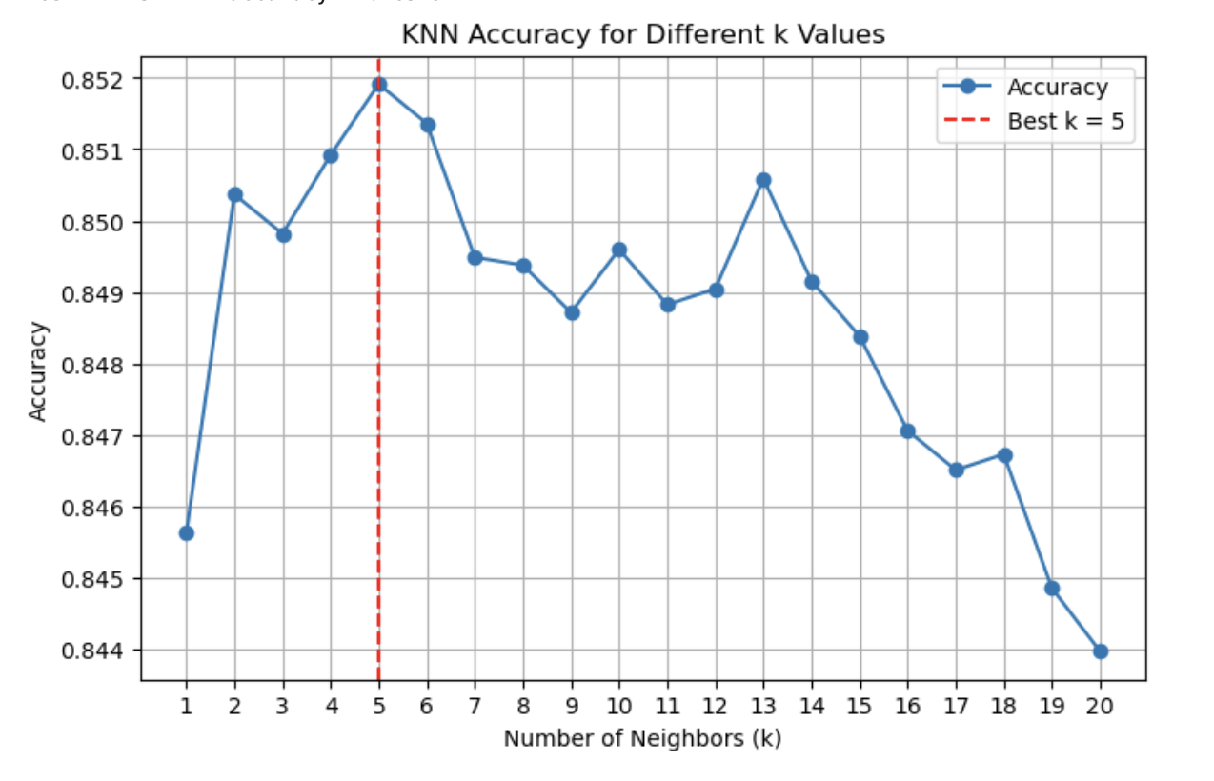
Feature Selection
(3 Tested)
Model Evaluation
(7 Classifiers)
Method | Base Model | # Features
Tree-based | Random Forest | Variable
SelectKBest | Mutual Info | 10
L1 (Lasso) | Logictic Reg | Variable
Logistic Regression
Naïve Bayes
Decision Tree
Random Forest
SVM
KNN ( k=5)
XGBoost
21combinations

Slide 12
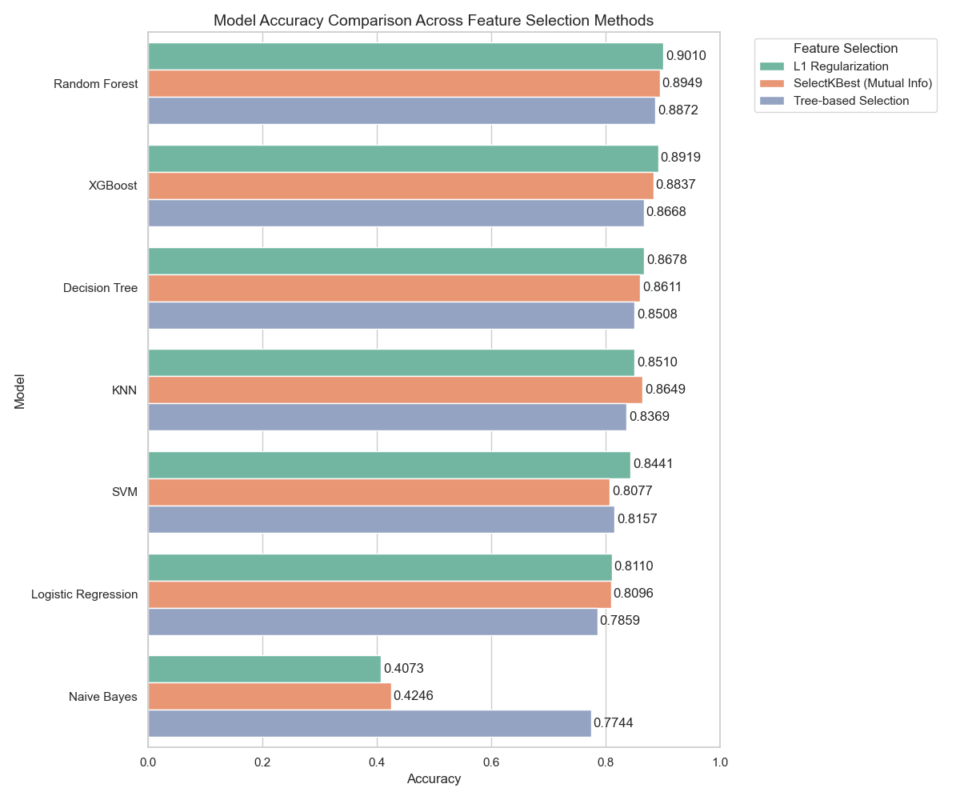
RESULTS
The Random Forest with L1 Regularization has highest accuracy 90.10%

Slide 13
CLASSIFICATION REPORT
Precision: Of all boookings the model predicted as Cancelled, how many were actually cancelled
TP/FP + TP
Recall: Of all actual cancelled bookings, how many did the model correctly identify?
TP/FN+TP
BEST MODEL
 | Precision | Recall | F1-score
Not_Canceled | 0.91 | 0.95 | 0.93
Canceled | 0.88 | 0.81 | 0.84
Accuracy |  |  | 0.90

Slide 14
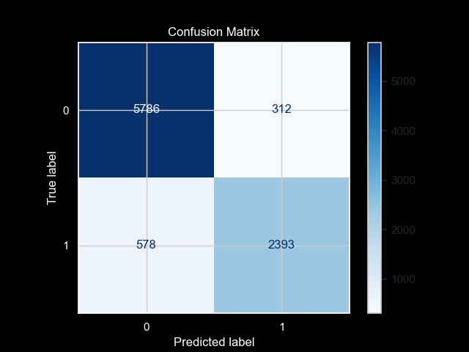
CONFUSION MATRIX
BEST MODEL

Slide 15
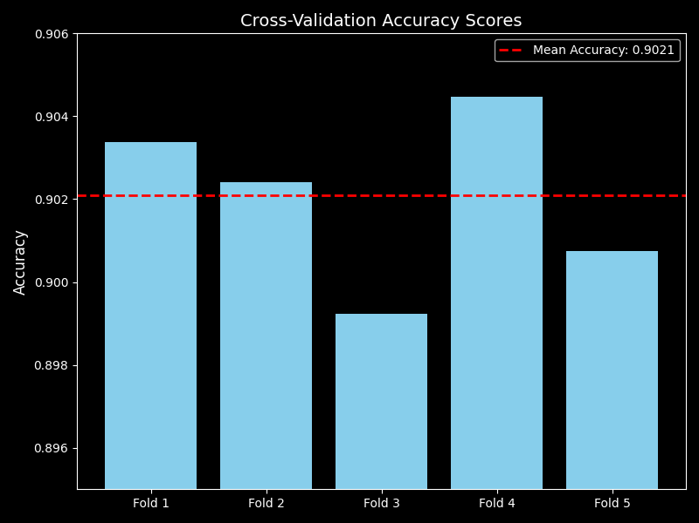
CROSS-VALIDATION
BEST MODEL

Slide 16
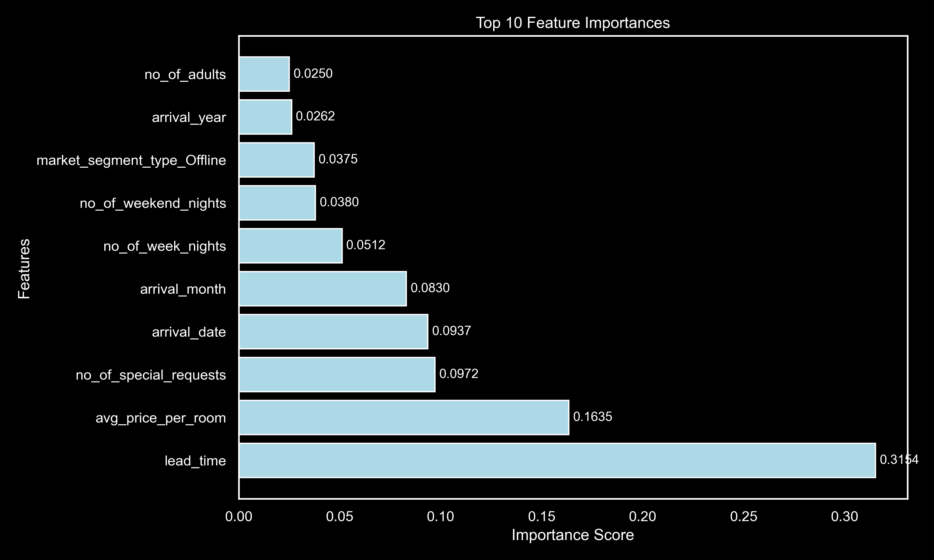
TOP 10 FEATURE IMPORTANCES
BEST MODEL

Slide 17

L1 cleans up the dataset by keeping only important features.
Random Forest then uses those clean features to learn strong patterns.
The two together avoid noise, reduce overfitting, and produce the most accurate predictions.
BEST
WHY?
Assumes all features are independent → not true for this dataset
Cannot capture nonlinear relationships
Performs poorly with correlated features
Naive Bayes has the lowest accuracy (40–77%)
WORST
Notes:
okay so the winner of this whole modeling showdown was Random Forest with L1 Regularization. L1 removed weak or noisy features, keeping only the most meaningful predictors. With a cleaner feature set, Random Forest was able to build hundreds of decision trees and capture complex interactions that simpler models cannot. Togetherm they produced the highest accuracy and the most stable results across the entire dataset.
On the other hand… Naïve Bayes was kinda struggling.
It assumes every feature is independent, but in our dataset, many features clearly influence one another. It can’t really understand those relationships, its predictions were way off — making it the worst performer
“So in conclusion, this project showed that machine learning can predict hotel cancellations with over 90% accuracy, thanks to the Random Forest + L1 combo.
The biggest drivers behind cancellations were lead time, average price per room, and number of special requests. This means that higher lead time (booking far in advance), higher room price, or fewer special requests tend to increase the likelihood of cancellation.
Overall, we built a model that’s rleliable,consistent, and actually useful for helping hotels reduce revenue loss and manage bookings smarter.”
“One of the biggest things we learned in this project is how much preprocessing and feature selection affect model performance.
In the beginning, we tried handling categorical data with LabelEncoder and manually transforming numerical features with log, sqrt, and scaling.
We even created new features like total nights and total people — but the highest accuracy we reached was only about 84% with KNN.
Once we switched to a structured pipeline with proper encoding, scaling, and L1 feature selection, our accuracy jumped to over 90%.
That really showed us that data preparation is just as important as the model we choose.
“Another key learning was that EDA doesn’t always tell the full story.
During, lead_time, special requests, and arrival_year looked like the strongest predictors, but final RF revealed that avg_price_per_room was actually one of the top features.
This taught us that machine learning models can capture deeper, nonlinear relationships that simple correlations don’t reveal.”

Slide 18

CONCLUSION
Deployment
Best Model
Key Drivers
Developed a full ML pipeline for hotel cancellation prediction that is ready for real operational use.
Random Forest + L1 Selection -> 90.10% accuracy.
Lead time, Average price per room, Number of special requests.

Slide 19

“How feature engineering and feature selection have a huge impact on accuracy.”
-LEARNINGS-

Slide 20
“EDA insights don’t always match model behavior."
-LEARNINGS-

Slide 21
Q&A

